Slide 1
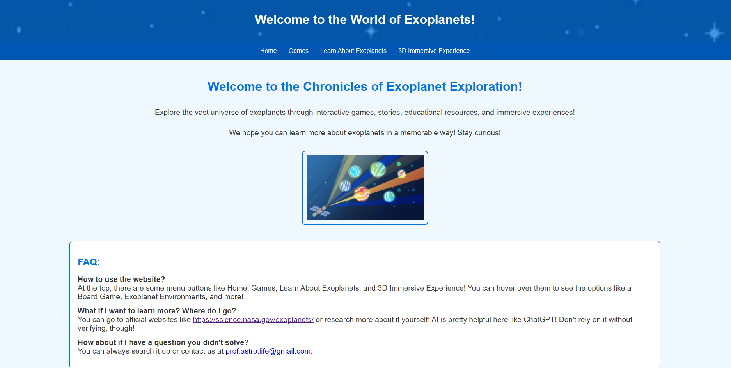
Chronicles of Exoplanet Exploration
Team - ExoplanetChronicles, Members - Aeparish M, Amia L, Aepkrish M
Live website - https://auroralynx.github.io/ExoplanetChronicles/

Slide 2
Flow of the presentation:
Usecase:
We’ve created a website which hosts interactive games, a printable board game and 3d immersive experiences and resources from NASA so that people can learn while enjoying and generate curiosity to dig deeper further.
In each slide we cover one aspect of our website.
We’re targeting kids from elementary and middle school because these are the main times kids develop their thoughts and understanding.
We hope to achieve bridging educational gaps and provide opportunities for kids who may not have access to engaging learning tools and hope to make knowledge accessible to everyone, regardless of background. Board games are a popular form of entertainment and creating a website with different resources accessible worldwide would be an unique way to integrate education and enjoyment at the same time.
To provide this game to underprivileged children, partnering with public schools and NGOs will ensure it serves as an educational tool while remaining affordable and accessible for communities in need.
To help grow children's interest in Exoplanets, and celestial objects outside our solar system

Slide 3
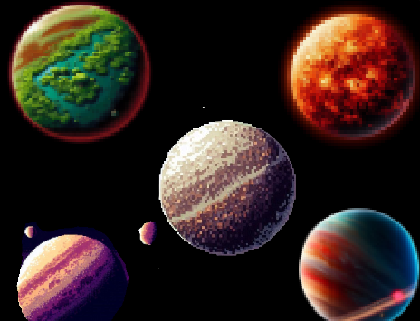
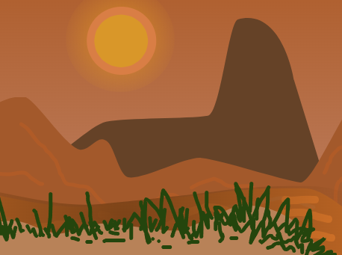
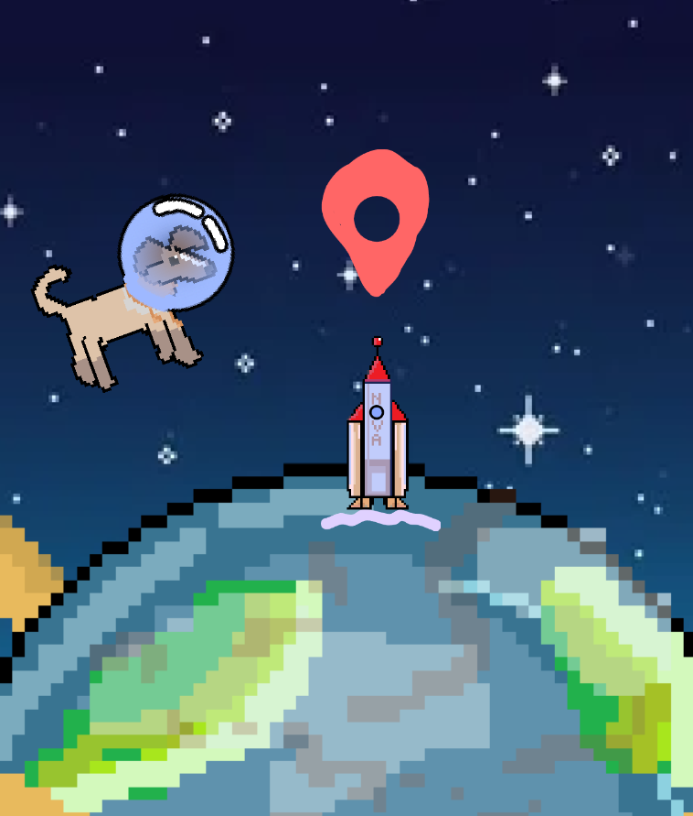
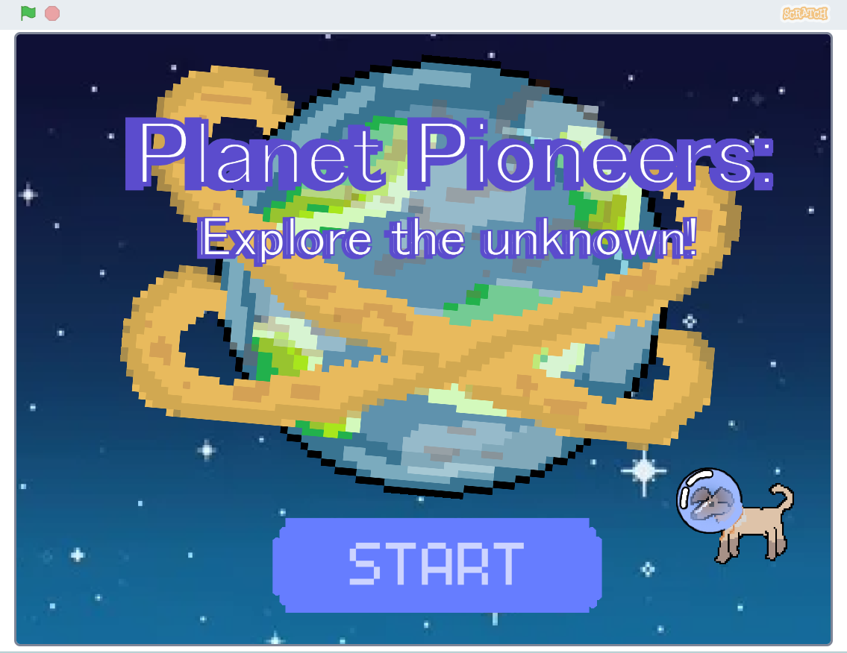
PLANET PIONEERS: EXPLORING THE UNKNOWN!
Through planet pioneers, users explore the vast worlds of exoplanets starting from the home planet of Laika, a dog cloned from the first dog in space. They venture from the dog’s dying planet Chrysomedak on a quest to save humanity, experiencing an exciting story. They learn about different exoplanets present throughout the universe and concepts in a thought provoking and engaging way. At the moment the only exoplanet which a world/parallax has been made for to be explored is kepler 186f.

Slide 4
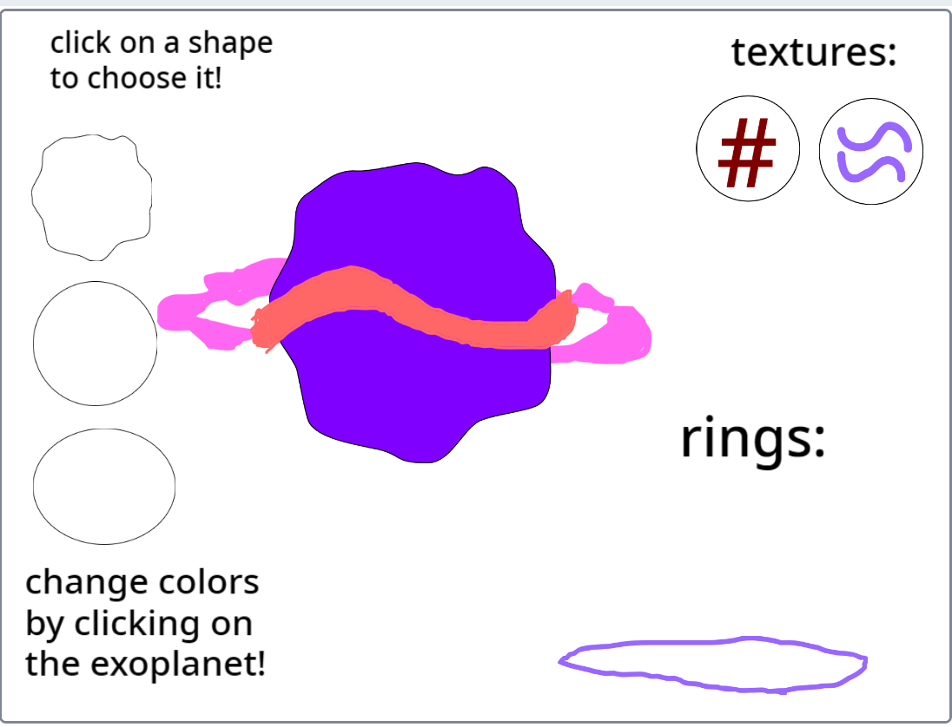
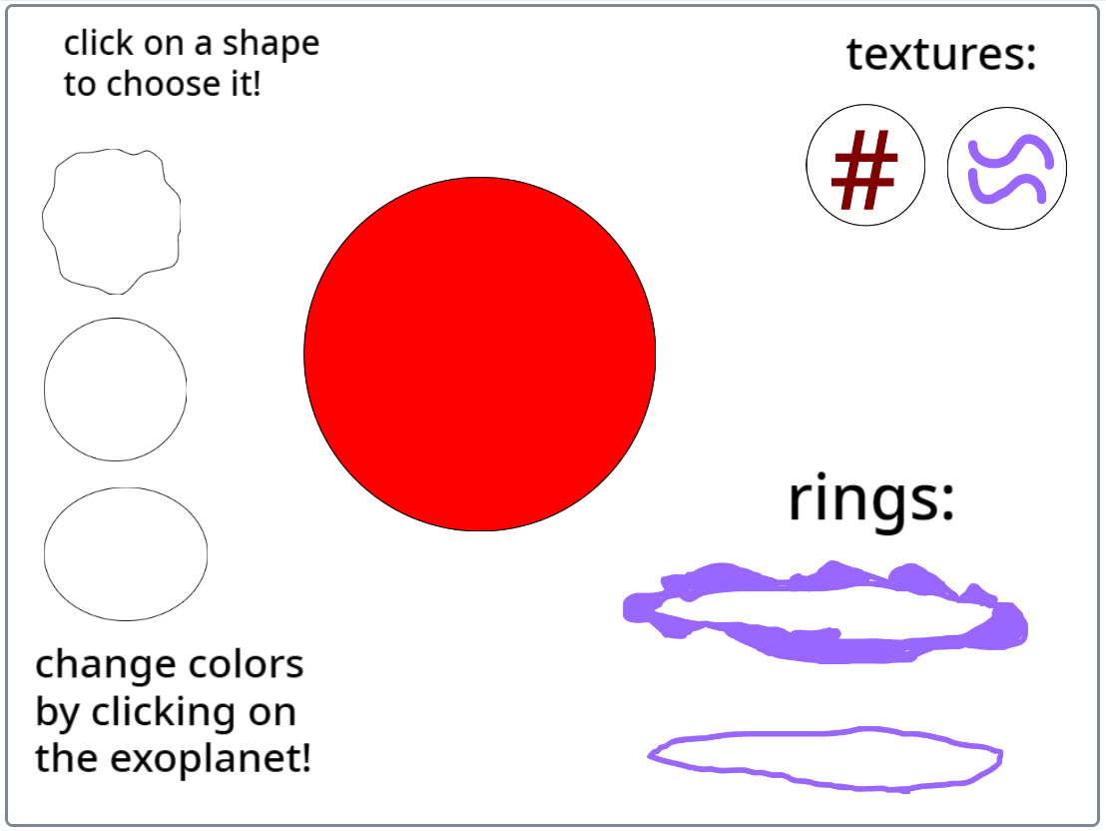
Exoplanet Creator Made by our 7 year old teammate (Aepkrish)
You can make your own exoplanet which includes colors, shapes, textures, rings, and more. It was made for elementary level kids mainly so that they can enjoy in an interactive way while nurturing their creativity. Some more things to be included in the future are more options of customising your own exoplanet and maybe even options to draw your own ideas!
Customised:
When started:

Slide 5
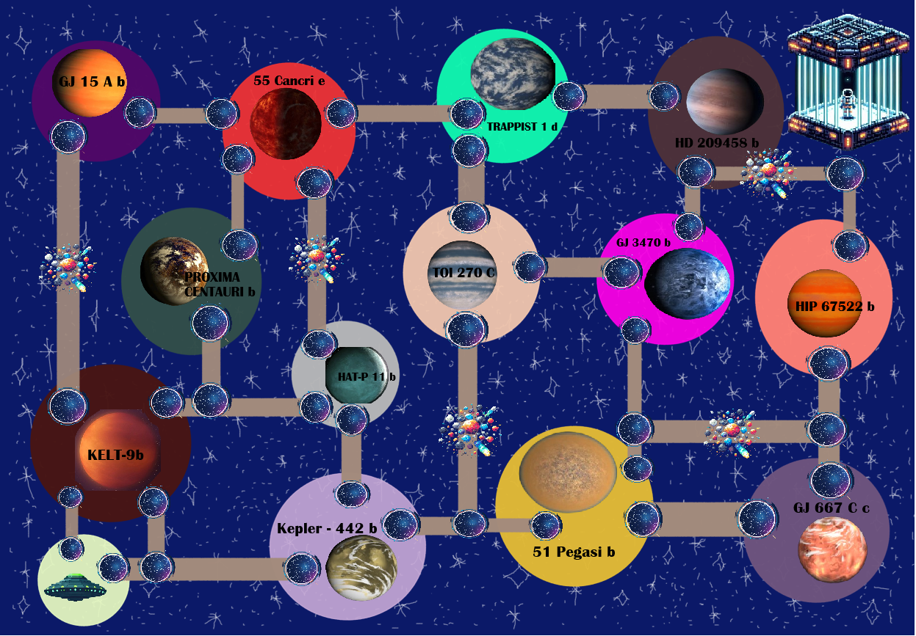
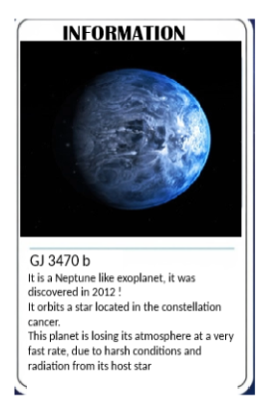
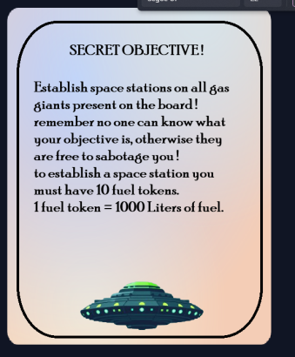

GALACTIC SETTLERS : THE RACE TO THE EXOPLANETS!
In "Galactic Settlers", players are space explorers discovering and settling distant exoplanets, trading resources, and encountering challenges along the way. Each player starts with 5 fuel tokens, a secret objective, and selects a figure to represent them. They move from one space portal to another.
When a player purchases an exoplanet or builds a space station, they share information about that planet with others. If they land on a cosmic storm they go to jail. The game ends when a player completes their secret objective or garners the most resources.
For the rules, procedure of the game and Pictorial representation - (also on our website) https://docs.google.com/document/d/1pvcSmogI3iTf-QrhIXCuRXuU_uKeeI-PhI0A4hEuYA8/

Slide 6
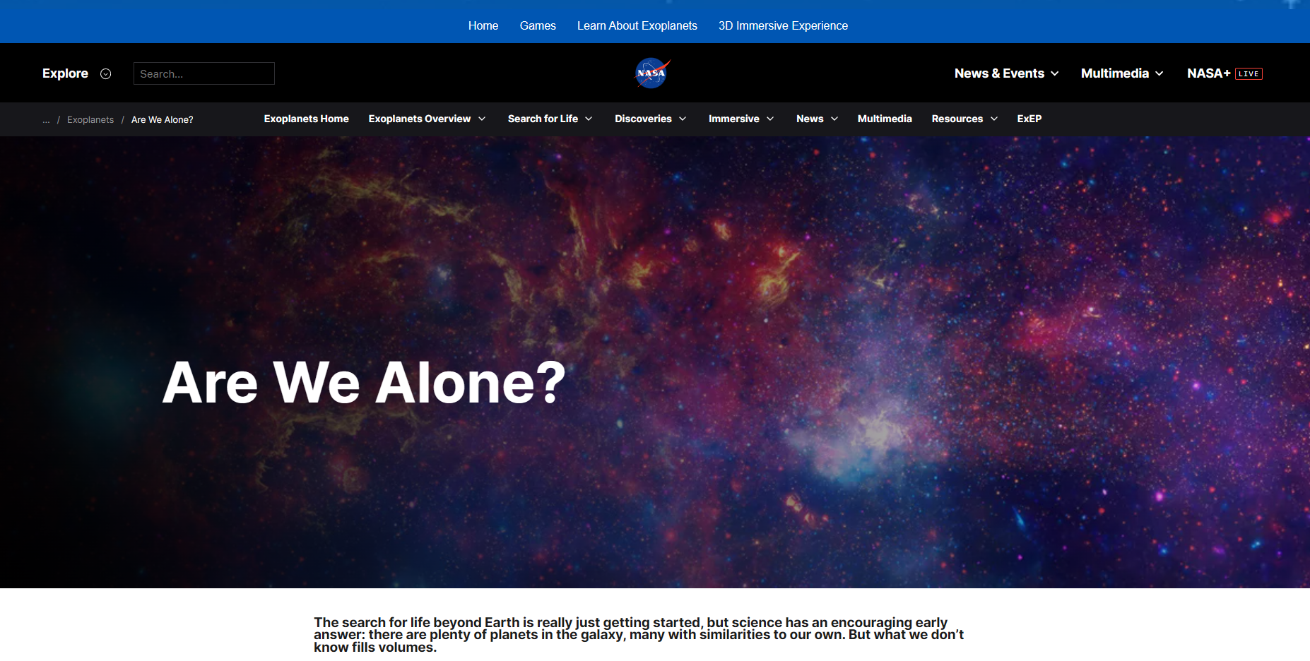
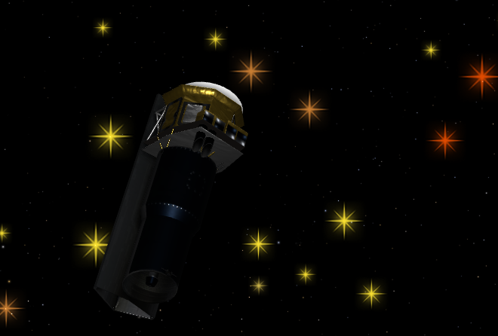
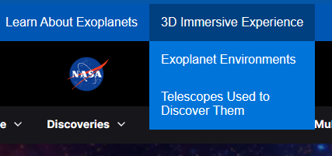
Learning and immersive tools:
We made use of NASA’s resources to the fullest and included 3D experiences using the exoplanet travel bureau finding the space telescope and exoplanet surface imaging made by an artist’s impression. We added websites to show the exoplanet catalogues and types to provide more information and encourage learning.

Slide 7
Resources:
https://science.nasa.gov/exoplanets/
Exoplanet Catalog - NASA Science
Exoplanet Travel Bureau | Explore – Exoplanet Exploration: Planets Beyond our Solar System (nasa.gov) <- sites in this mainly.
Are We Alone? - NASA Science
Overview - NASA Science
Chatgpt to help with the website code, copilot to generate images.
Future improvements:
There were many things that would’ve potentially been included like more activities when discussing exoplanet types and buffs (for example speeding up a rocket, better travel or even communicating with aliens) enabling a much more interactive environment than the current state. Along with this, more levels could be added like greater exploration and more animation with clearer storytelling to ensure a good experience.

